Slide 2
Dosage compensation extra slides

Slide 3
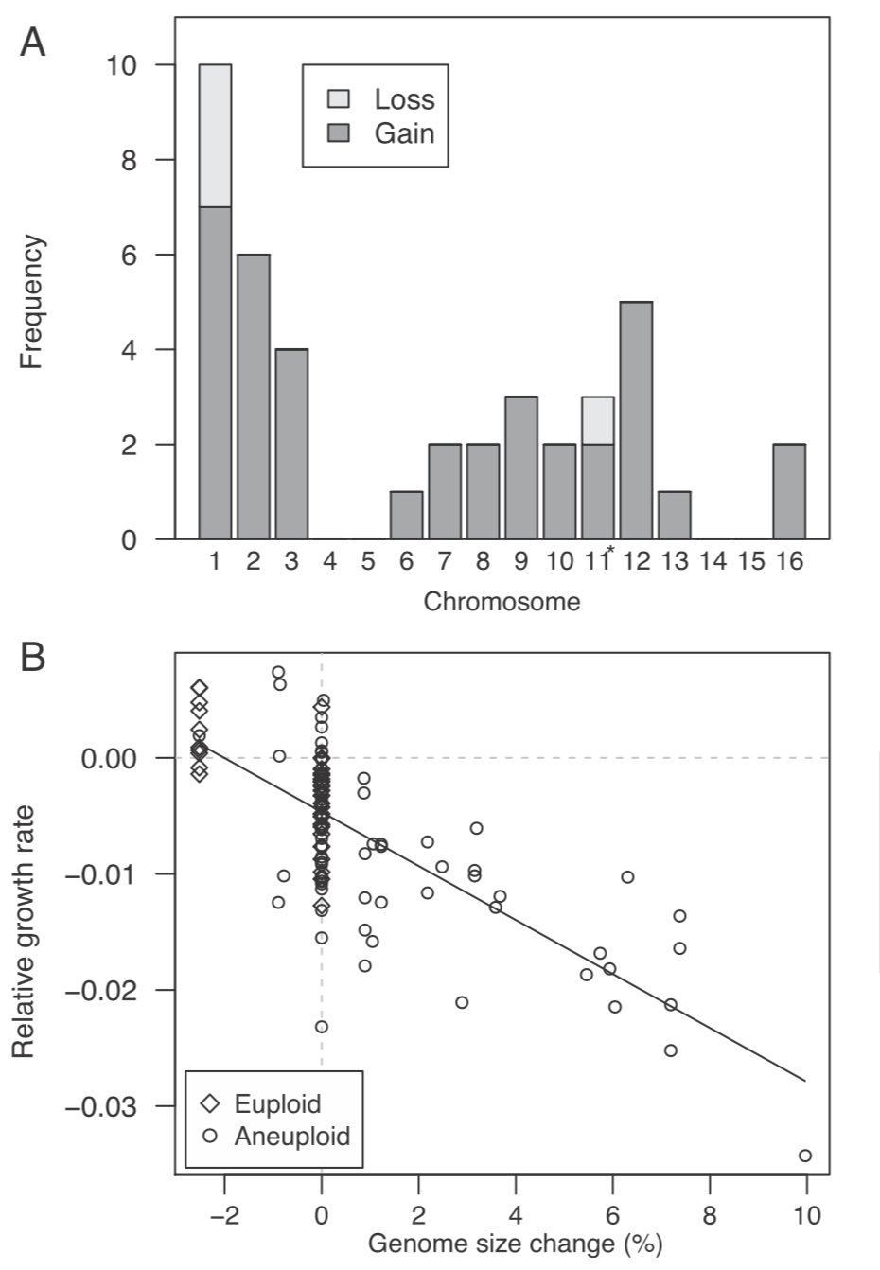
Sharp et al Aneuploids

Slide 5
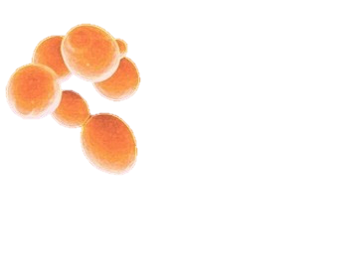
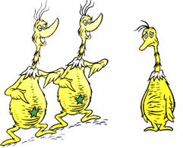
SNP Results
Strain | # mutations | # lines | Average mutations per line | Rate (SNPs/base /generation) +/- 1 SE
H0 | 152 | 36 | 4.22 | 1.87 x 10⁻¹⁰ +/- 1.80 x 10⁻¹¹
D0 | 153 | 39 | 3.92 | 1.82 x 10⁻¹⁰ +/- 1.94 x 10⁻¹¹
D1 | 155 | 33 | 4.69 | 2.04 x 10⁻¹⁰ +/- 1.74 x 10⁻¹²

Slide 6
Multinucleotide Mutations Results
Strain | # mutations | # lines | Average length | Rate (MNMs/base/generation) +/- 1 SE
H0 | 5 | 36 | 18.8 | 6.16 x 10⁻¹² +/- 1.24 x 10⁻¹¹
D0 | 9 | 39 | 9.67 | 1.02 x 10⁻¹¹ +/- 4.45 x 10⁻¹²
D1 | 21 | 33 | 20.14 | 2.77 x 10⁻¹¹ +/- 1.38 x 10⁻¹¹

Slide 7
Indel Results (<50bp)
Strain | # mutations | # lines | Gain/Loss | Rate (indels/base/ generation) +/- 1 SE
H0 | 12 | 36 | Loss 10 nt | 1.48 x 10⁻¹¹ +/- 4.88 x 10⁻¹²
D0 | 18 | 39 | Loss 26 nt | 2.05 x 10⁻¹¹ +/- 5.33 x 10⁻¹²
D1 | 15 | 33 | Gain 9.7 nt | 1.98 x 10⁻¹¹ +/- 6.06 x 10⁻¹²
**
Notes:
Largest insertion in D1: 50bp
D0: 19bp
H0: 46bp
Largest deletion in D1: 35bp
D0: 25bp
H0: 13bp

Slide 8
Ty1 Transposition Rate in D1 Lines
144 transposition events in 33 lines
Highest # events in a line: 8
Every line had evidence for at least one transposition event
2.3 x 10⁻³ transpositions/generation
Previous findings: 1.16 x 10⁻⁴ events/generation (Moore et al 2004)
1-copy strain (no CNC acting)
“Restrictive” strains: 6 x 10⁻⁸ events/generation

Slide 9
Ty1 transpositions/LTR information

Slide 10
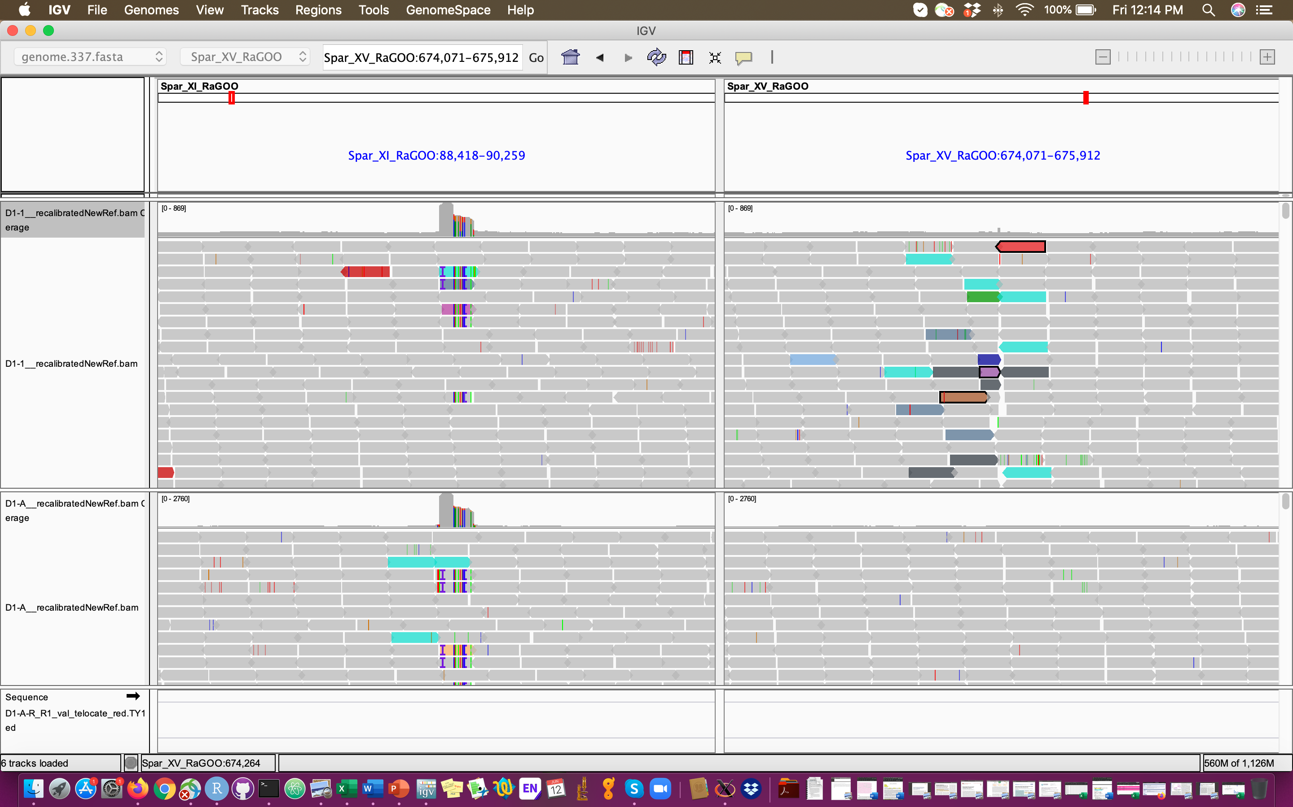
Indel locations related to LTRs– D1
Right plot is location of indel in D1-1; does not show up in ancestor but the corresponding matching mates of some reads are in the same location in the ancestor as the derived sample
S. Par XVI

Slide 11
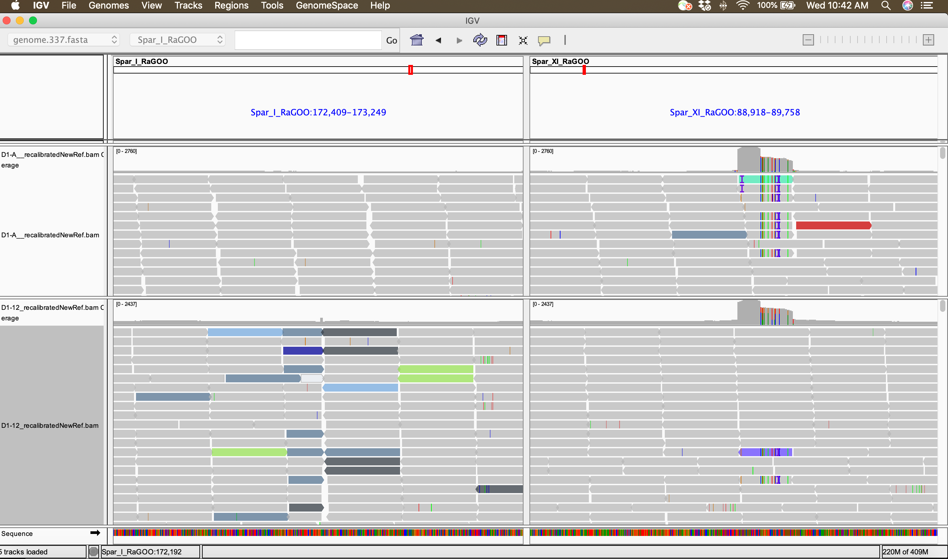

Slide 12
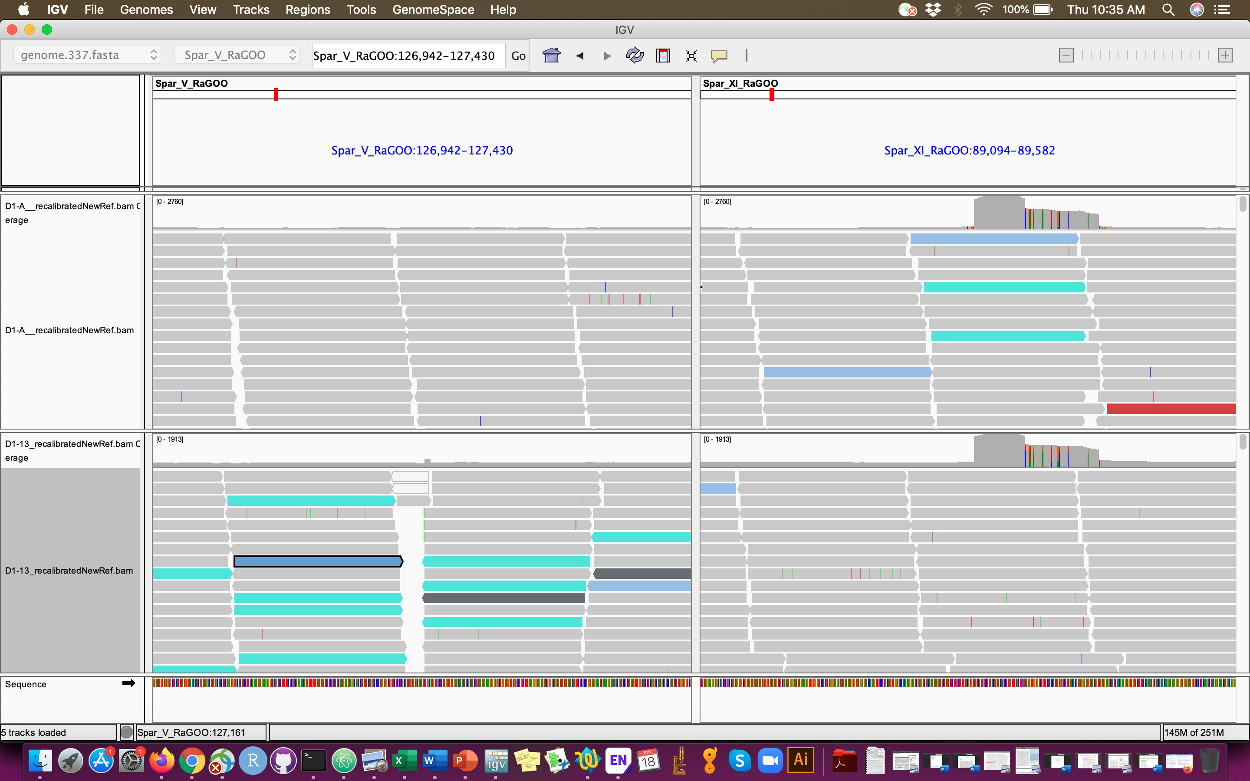

Slide 13
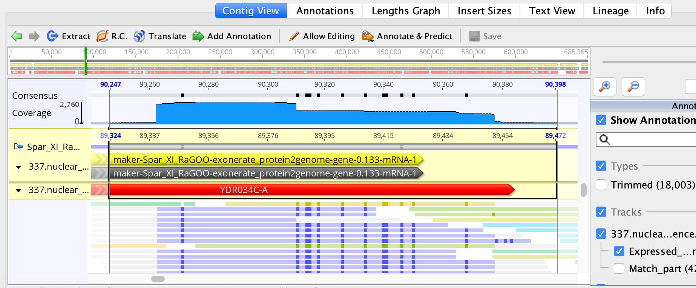
Maps to YDR034C-A which is a putative protein of unknown function and lies within the solo Ty1 LTR element YDRWdelta7

Slide 14
Indels in D1 map to LTRs
#CHROM | POS | REF | ALT | % match | name | description | length
Spar_I_RaGOO | 172829 | T | TGATAATGAGAATTGGGTGAATGTTGAGATAATTGTTGGGATTCCATTGTTGATAAAGGCTATAATATTAGGTATACAGAATATACTAGTAATGTAAATACTAGTTAGTAGATGATAGTTGATTTCTATTCCAACA | 98% | YPRCdelta23 | Ty1 LTR | 338 bp
Spar_III_RaGOO | 133181 | T | TAAATGTGAGAATTGGGTGAATGTTGAGATAATTGTTGGGATTCCATTGTTGATAAAGGCTATAATATTAGGTATACAGAATATACTAGTAATGTAAATACTAGTTAGTAGATGATAGTTGATTTCTATTCCAACA | 98% | YLRCdelta7 | Ty1 LTR | 335 bp
Spar_IX_RaGOO | 312016 | T | TCACTATATGAGAATTGGGTGAATGTTGAGATAATTGTTGGGATTCCATTGTTGATAAAGGCTATAATATTAGGTATACAGAATATACTAGTAATGTAAATACTAGTTAGTAGATGATAGTTGATTTCTATTCCAA | 98% | YCLWdelta15 | Ty1 LTR | 337 bp
Spar_V_RaGOO | 127186 | G | GCTGGCTGAGAATTGGGTGAATGTTGAGATAATTGTTGGGATTCCATTGTTGATAAAGGCTATAATATTAGGTATACAGAATATACTAGTAATGTAAATACTAGTTAGTAGATGATAGTTGATTTCTATTCCAACA | 98% | YCRCdelta6 | Ty1 LTR | 332 bp
Spar_V_RaGOO | 431571 | T | TGTTCATGAGAATTGGGTGAATGTTGAGATAATTGTTGGGATTCCATTGTTGATAAAGGCTATAATATTAGGTATACAGAATATACTAGTAATGTAAATACTAGTTAGTAGATGATAGTTGATTTCTATTCCAACA | 98% | YORCdelta25 | Ty1 LTR | 332 bp
Spar_V_RaGOO | 438466 | T | TTCTTTTGAGAATTGGGTGAATGTTGAGATAATTGTTGGGATTCCATTGTTGATAAAGGCTATAATATTAGGTATACAGAATATACTAGTAATGTAAATACTAGTTAGTAGATGATAGTTGATTTCTATTCCAACA | 98% | YNLWdelta4 | Ty1 LTR | 334 bp
Spar_VI_RaGOO | 197951 | T | TATTACTGAGAATTGGGTGAATGTTGAGATAATTGTTGGGATTCCATTGTTGATAAAGGCTATAATATTAGGTATACAGAATATACTAGTAATGTAAATACTAGTTAGTAGATGATAGTTGATTTCTATTCCAACA | 97% | YPLWdelta4 | Ty1 LTR | 337 bp
Spar_VII_RaGOO | 407618 | C | CCTTAGTGAGAATTGGGTGAATGTTGAGATAATTGTTGGGATTCCATTGTTGATAAAGGCTATAATATTAGGTATACAGAATATACTAGTAATGTAAATACTAGTTAGTAGATGATAGTTGATTTCTATTCCAACA | 97% | YLRCdelta7 | Ty1 LTR | 335 bp
Spar_VII_RaGOO | 839634 | T | TCTAATTGAGAATTGGGTGAATGTTGAGATAATTGTTGGGATTCCATTGTTGATAAAGGCTATAATATTAGGTATACAGAATATACTAGTAATGTAAATACTAGTTAGTAGATGATAGTTGATTTCTATTCCAACA | 98% | YKRCdelta8 | Ty1 LTR | 332 bp
Spar_VIII_RaGOO | 442242 | T | TCGAGTTGAGAATTGGGTGAATGTTGAGATAATTGTTGGGATTCCATTGTTGATAAAGGCTATAATATTAGGTATACAGAATATACTAGTAATGTAAATACTAGTTAGTAGATGATAGTTGATTTCTATTCCAACA | 98% | YNLCdelta1 | Ty1 LTR | 332 bp
Spar_X_RaGOO | 43017 | C | CGATAATGTTGGAATAGAAATCAACTATCATCTACTAACTAGTATTTACATTACTAGTATATTCTGTATACCTAATATTATAGCCTTTATCAACAATGGAATCCCAACAATTATCTCAACATTCACCCAATTCTCA | 98% | YERCdelta20 | Ty1 LTR | 337 bp
Spar_X_RaGOO | 183598 | G | GGTATCTGAGAATTGGGTGAATGTTGAGATAATTGTTGGGATTCCATTGTTGATAAAGGCTATAATATTAGGTATACAGAATATACTAGTAATGTAAATACTAGTTAGTAGATGATAGTTGATTTCTATTCCAACA | 98% | YCRCdelta6 | Ty1 LTR | 332 bp
Spar_X_RaGOO | 376694 | T | TGGCCATGTTGGAATAGAAATCAACTATCATCTACTAACTAGTATTTACATTACTAGTATATTCTGTATACCTAATATTATAGCCTTTATCAACAATGGAATCCCAACAATTATCTCAACATTCACCCAATTCTCA | 98% | YERCdelta20 | Ty1 LTR | 337 bp
Spar_X_RaGOO | 395751 | G | GGTTAATGTTGGAATAGAAATCAACTATCATCTACTAACTAGTATTTACATTACTAGTATATTCTGTATACCTAATATTATAGCCTTTATCAACAATGGAATCCCAACAATTATCTCAACATTCACCCAATTCTCA | 98% | YERCdelta20 | Ty1 LTR | 338 bp
Spar_XII_RaGOO | 773415 | T | TGAACGTGTTGGAATAGAAATCAACTATCATCTACTAACTAGTATTTACATTACTAGTATATTCTGTATACCTAATATTATAGCCTTTATCAACAATGGAATCCCAACAATTATCTCAACATTCACCCAATTCTCA | 98% | YERCdelta20 | Ty1 LTR | 337 bp
Spar_XII_RaGOO | 856583 | T | TATTATTTGTTGGAATAGAAATCAACTATCATCTACTAACTAGTATTTACATTACTAGTATATTCTGTATACCTAATATTATAGCCTTTATCAACAATGGAATCCCAACAATTATCTCAACATTCACCCAATTCTC | 98% | YERCdelta20 | Ty1 LTR | 337 bp
Spar_XIII_RaGOO | 802251 | T | TCTCCTTGAGAATTGGGTGAATGTTGAGATAATTGTTGGGATTCCATTGTTGATAAAGGCTATAATATTAGGTATACAGAATATACTAGTAATGTAAATACTAGTTAGTAGATGATAGTTGATTTCTATTCCAACA | 98% | YCLWdelta15 | Ty1 LTR | 337 bp
Spar_XIV_RaGOO | 543184 | G | GGATCTTGAGAATTGGGTGAATGTTGAGATAATTGTTGGGATTCCATTGTTGATAAAGGCTATAATATTAGGTATACAGAATATACTAGTAATGTAAATACTAGTTAGTAGATGATAGTTGATTTCTATTCCAACA | 98% | YORCdelta25 | Ty1 LTR | 332 bp
Spar_XV_RaGOO | 98450 | T | TCACATATTGAGAATTGGGTGAATGTTGAGATAATTGTTGGGATTCCATTGTTGATAAAGGCTATAATATTAGGTATACAGAATATACTAGTAATGTAAATACTAGTTAGTAGATGATAGTTGATTTCTATTCCAA | 98% | YKRCdelta8 | Ty1 LTR | 332 bp
Spar_XV_RaGOO | 674966 | T | TGATTCTGTTGGAATAGAAATCAACTATCATCTACTAACTAGTATTTACATTACTAGTATATTCTGTATACCTAATATTATAGCCTTTATCAACAATGGAATCCCAACAATTATCTCAACATTCACCCAATTCTCA | 98% | YERCdelta20 | Ty1 LTR | 337 bp

Slide 15
Most indels map to YECRdelta20 LTR

Slide 16
D20 S. paradoxus stuff

Slide 17
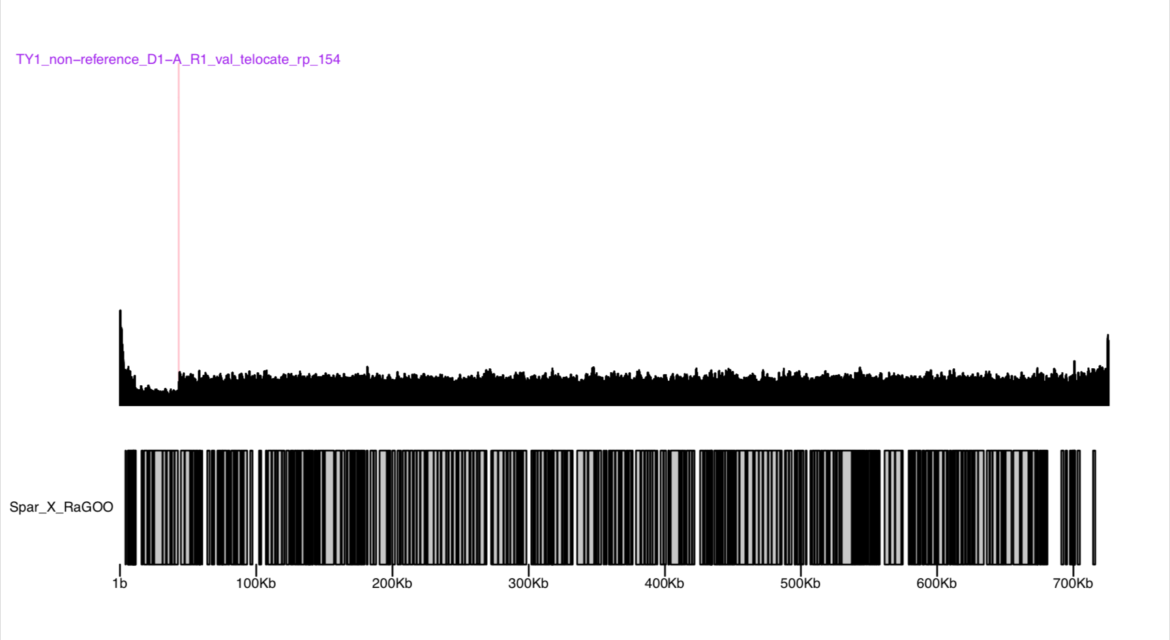

Slide 18
Methods Info

Slide 19
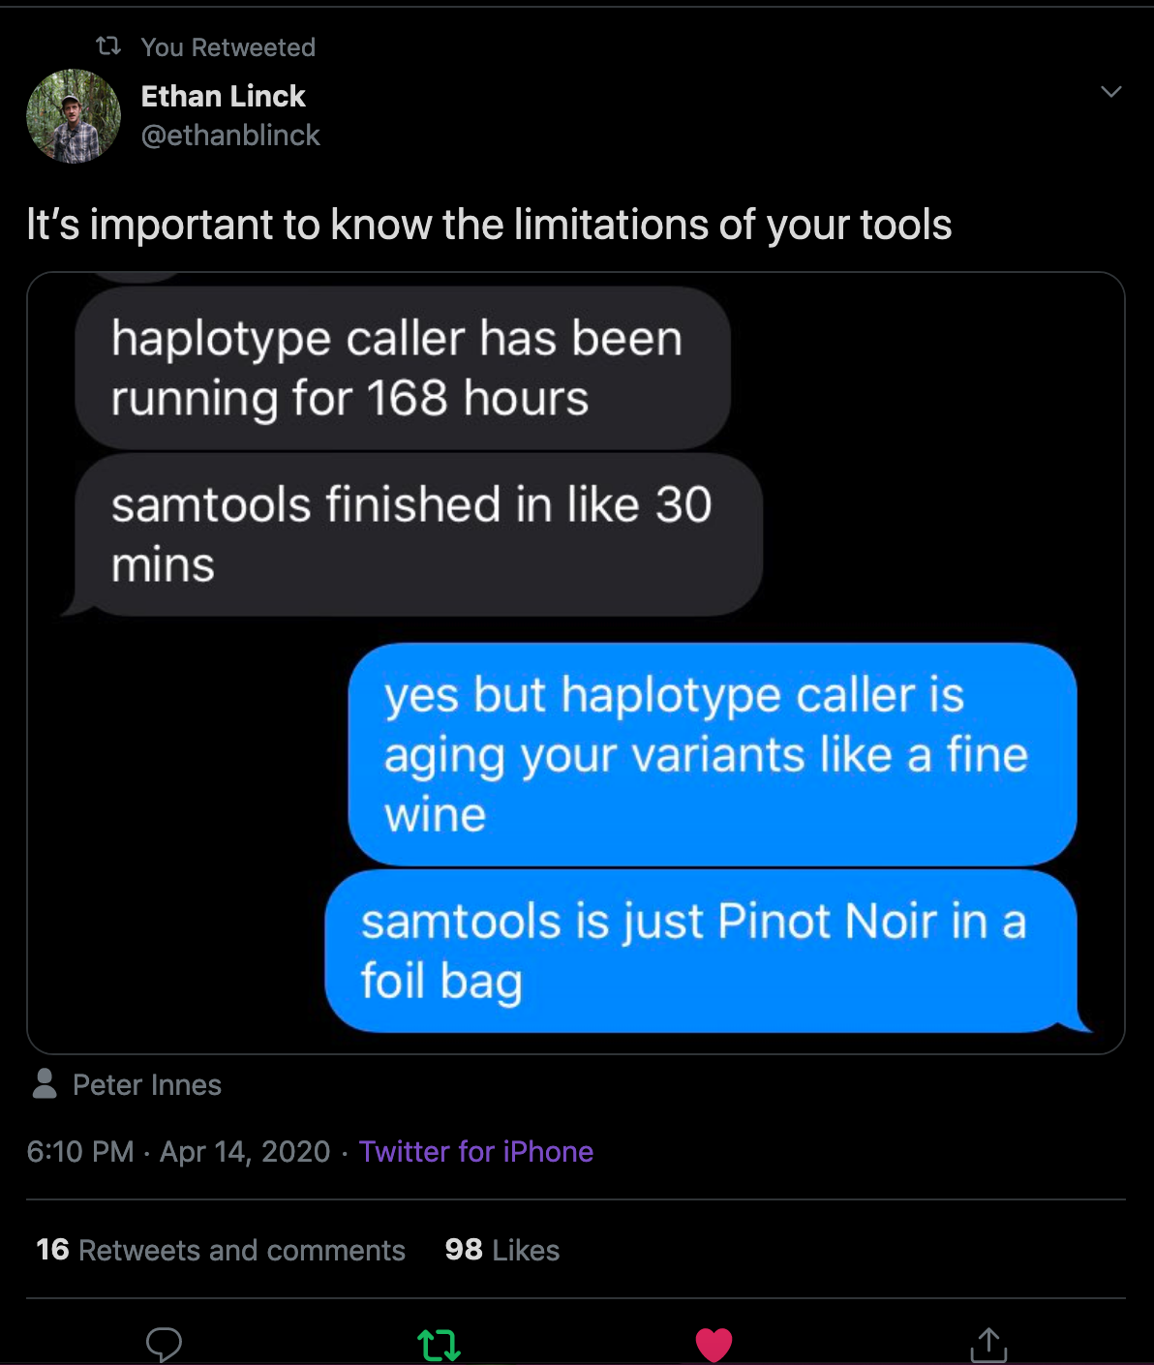

Slide 20
S. paradoxus strains
DG1768: a Ty1‐less strain, (MATα his3‐Δ200hisG ura3) derived from strain 337, kindly provided by J. Adams (Wilke and Adams, 1992), as previously described (Garfinkel et al., 2003).
DG4005 (rederived DG2454): DG1768 + Ty1-4253 (inserted in ChrX between RAD7 and CDC8 and adjacent to a Gly-tRNA gene, see Garfinkel et al. Genetics 2005 enclosed).

Slide 21
MA
200 days of transfer, 1 transfer every other day
100 transfers, 2000 generations
stored every 10 transfers
sequenced 100th transfer only
goal was 48 replicates per genotype + progenitors = ~200 total samples
<5 replicates missing from each genotype

Slide 22
337 genome assembly and polishing
Done by Casey Bergman’s lab
PacBio single cell Seqel
Spar 337
Pilon polishing of PacBio reads with Illumina data
5 rounds
Used RaGOO to scaffold pilon polished genome into chromosomes
Annotated using LRSDAY
Details at https://github.com/bergmanlab/jingxuan/issues/12

Slide 23
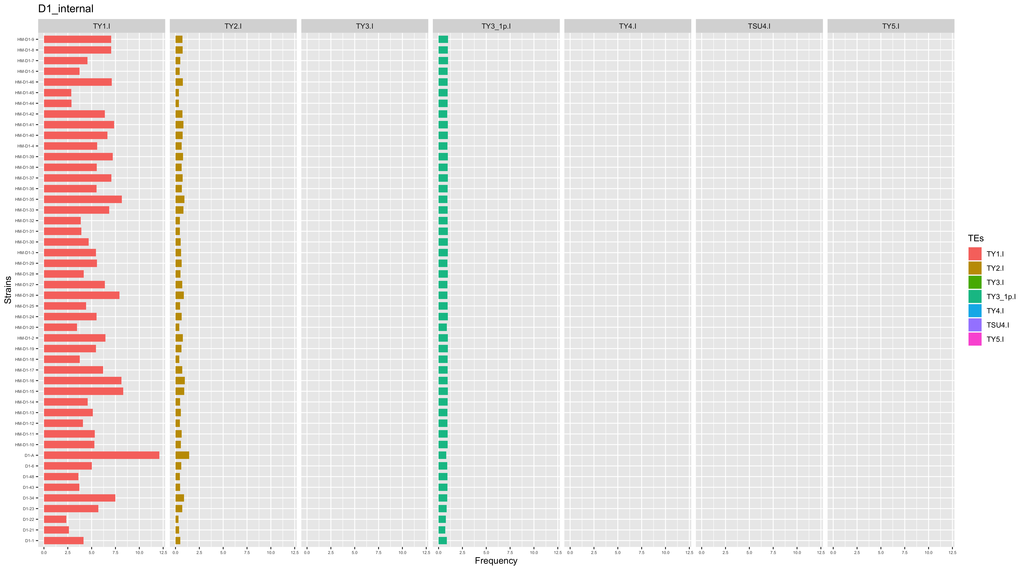
D1 samples

Slide 24
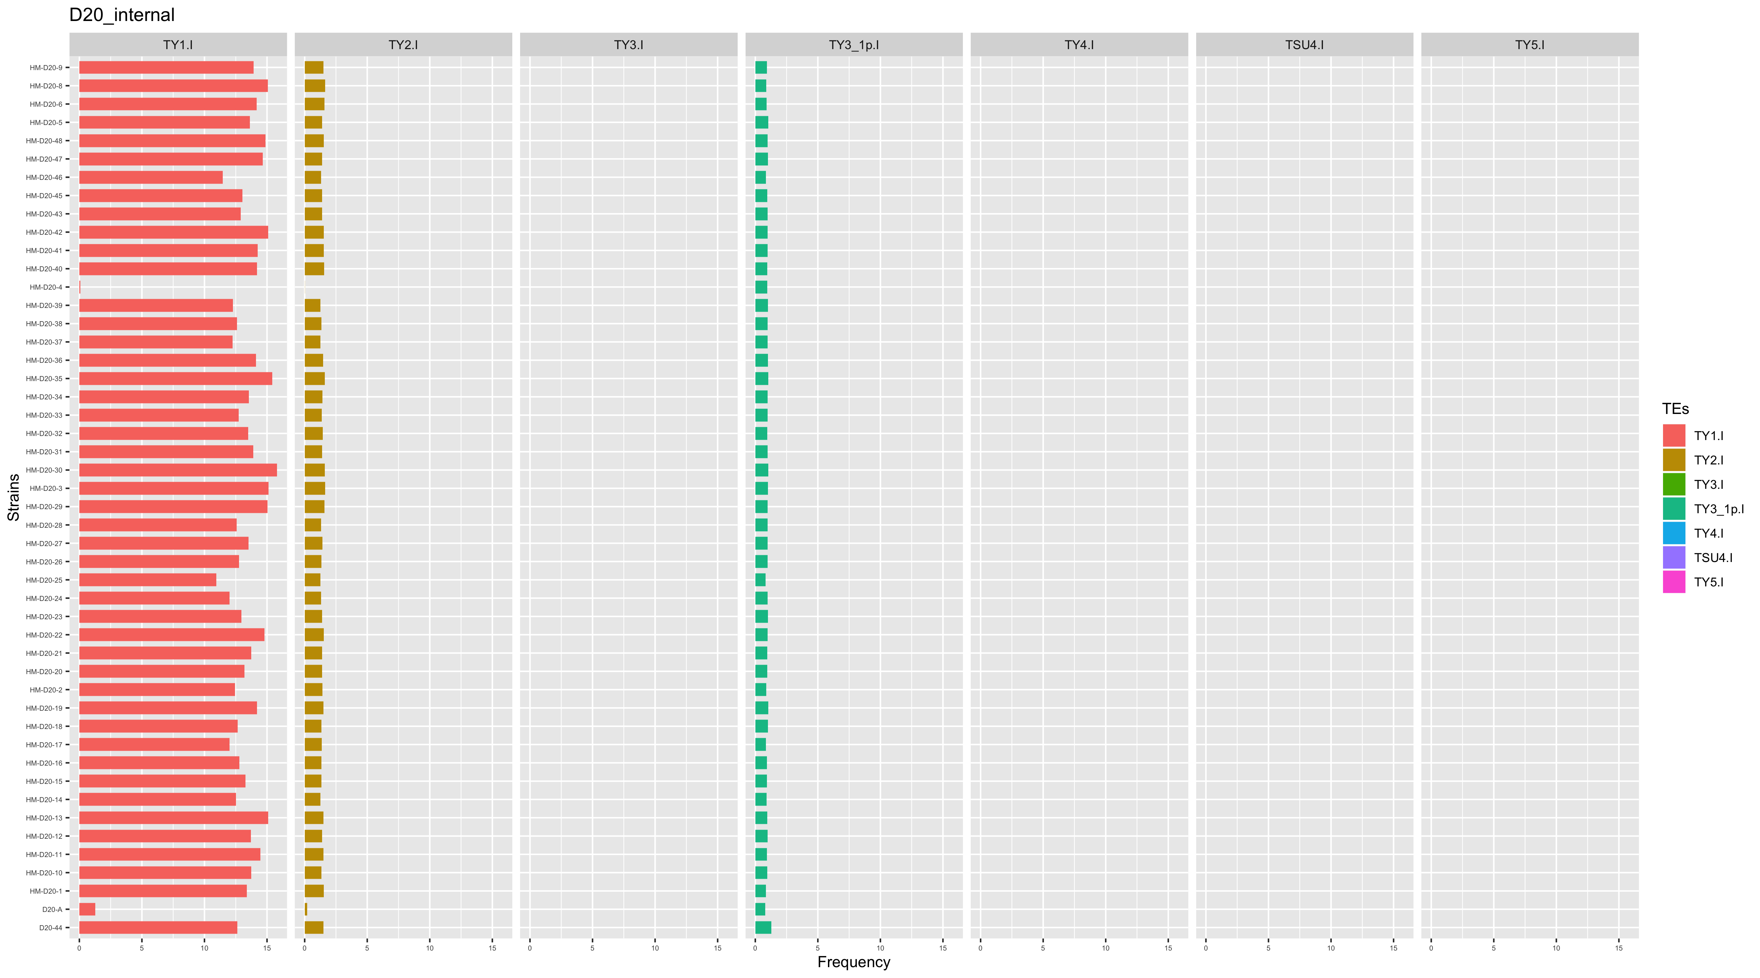
D20 samples

Slide 25
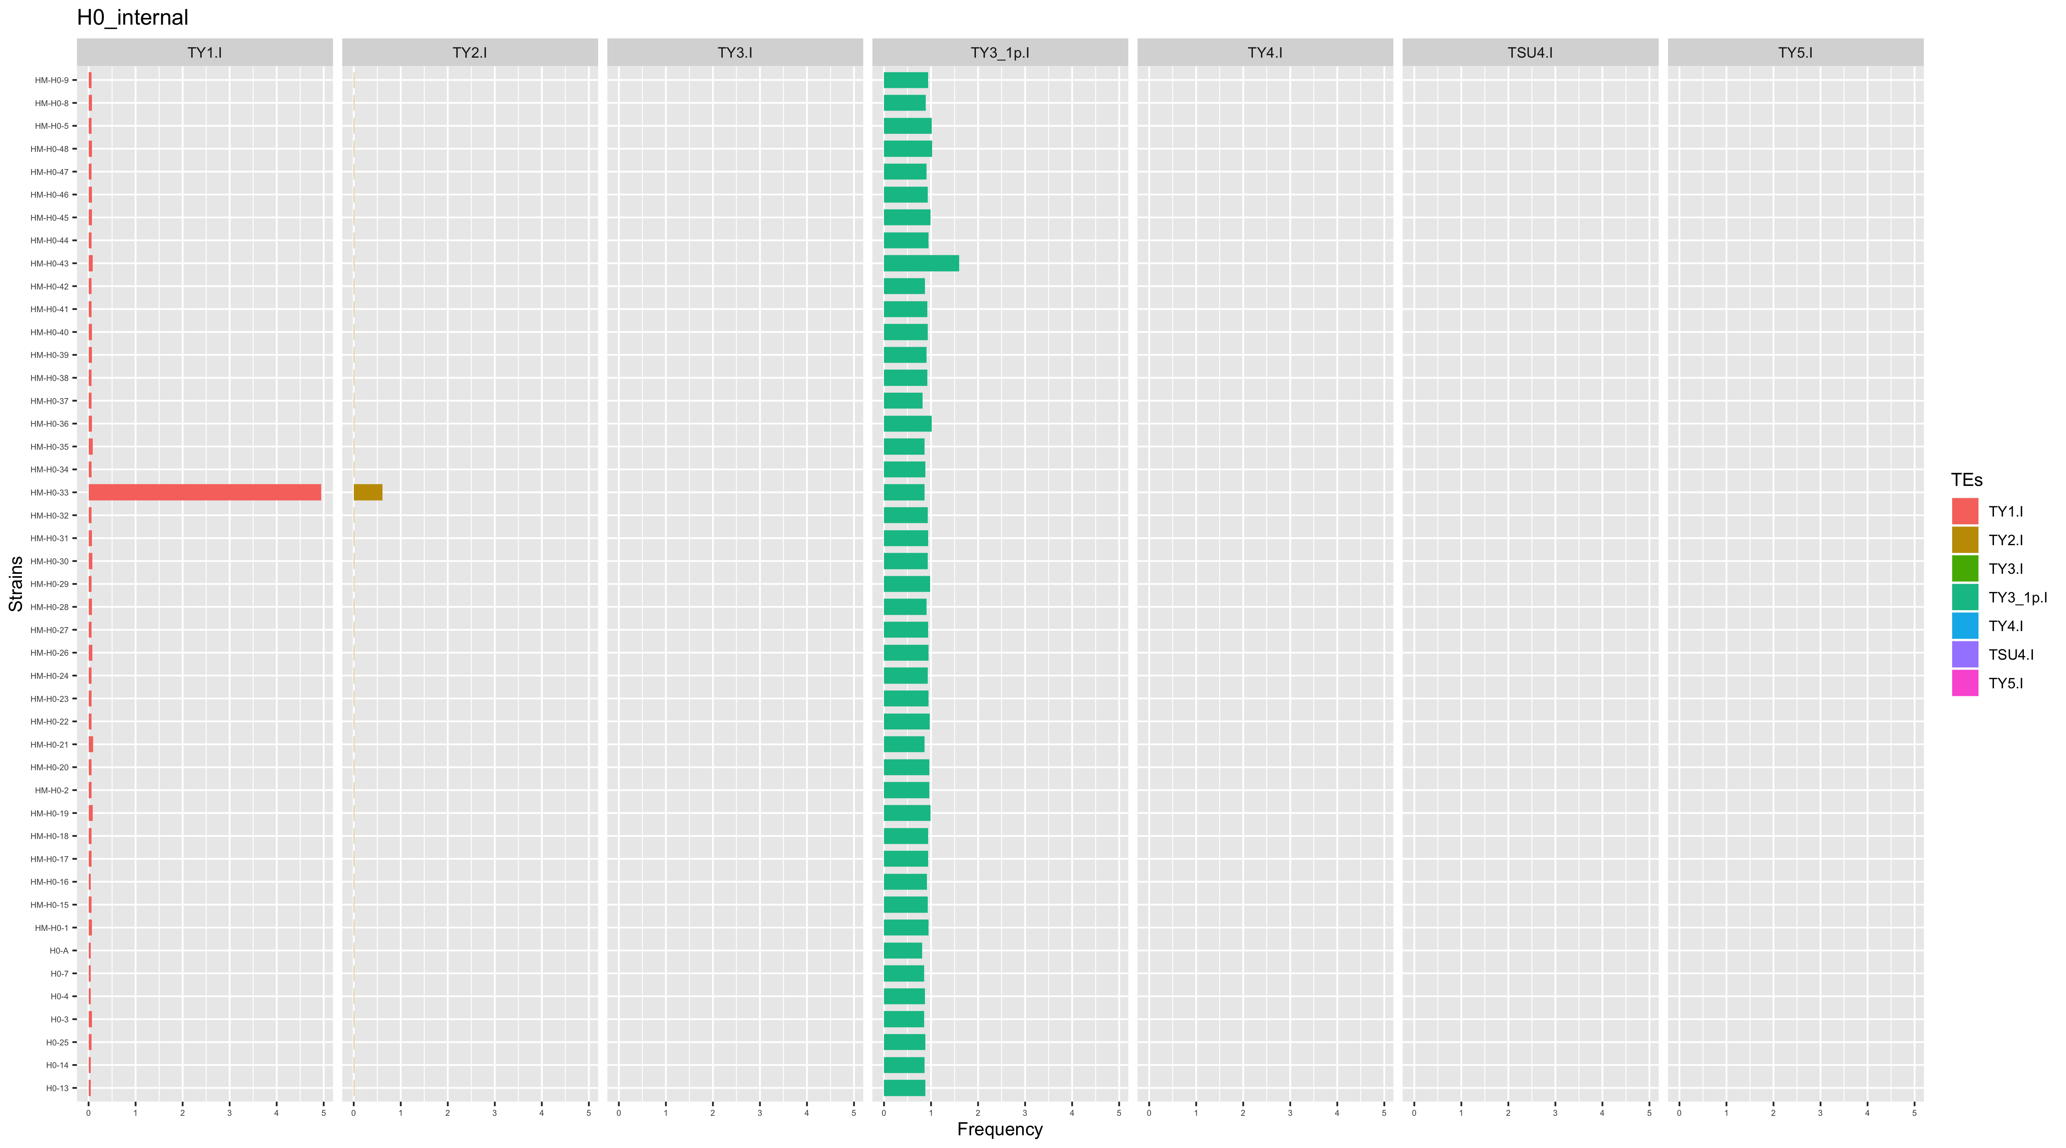
H0 samples

Slide 26
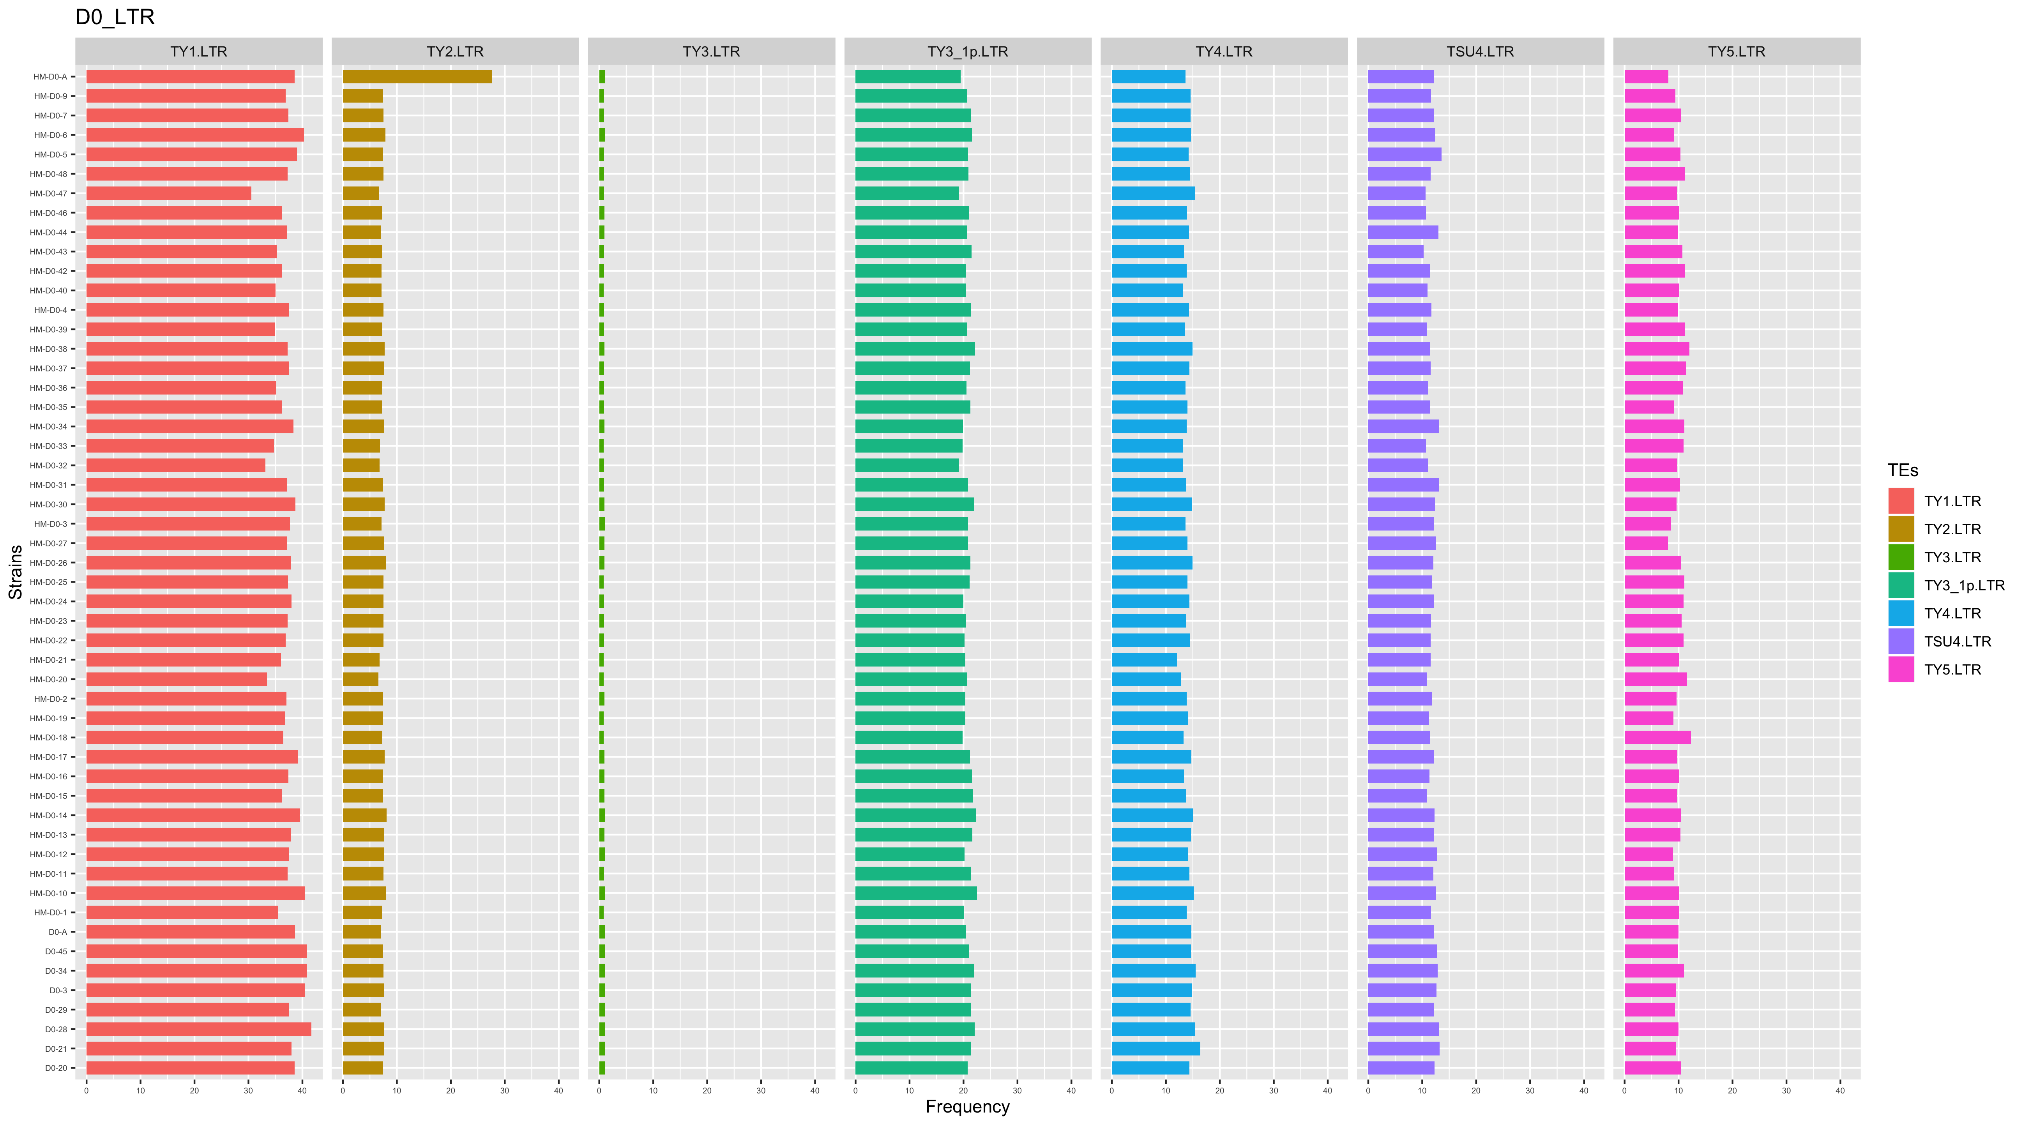
LTR copy number estimates

Slide 27
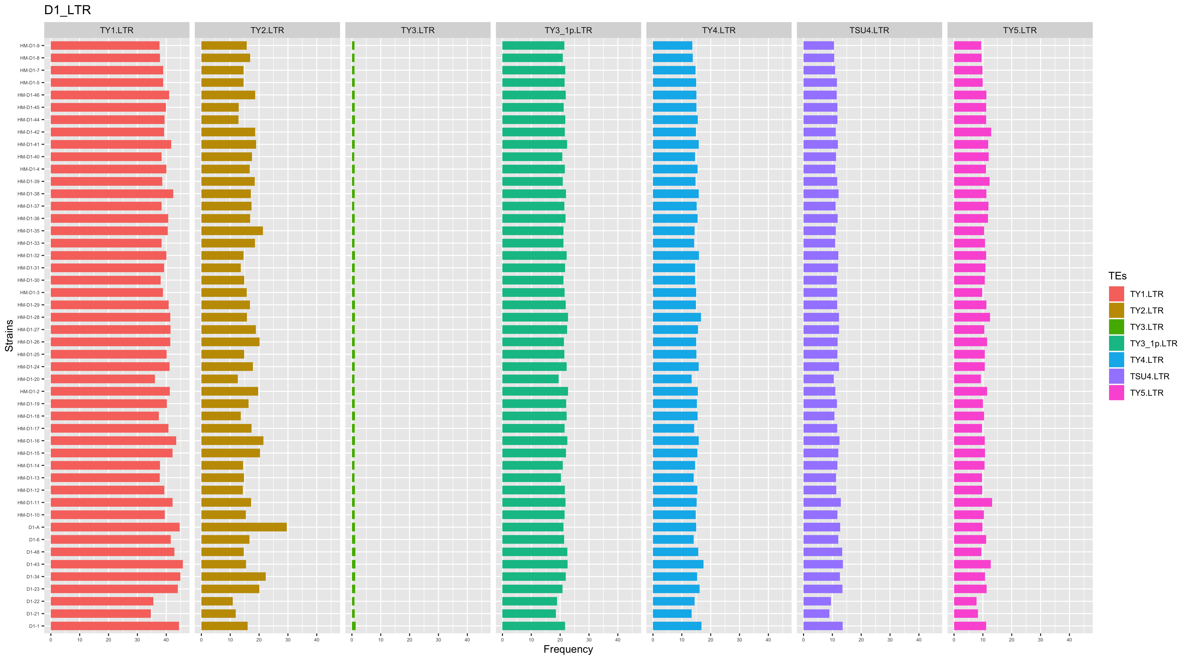

Slide 28
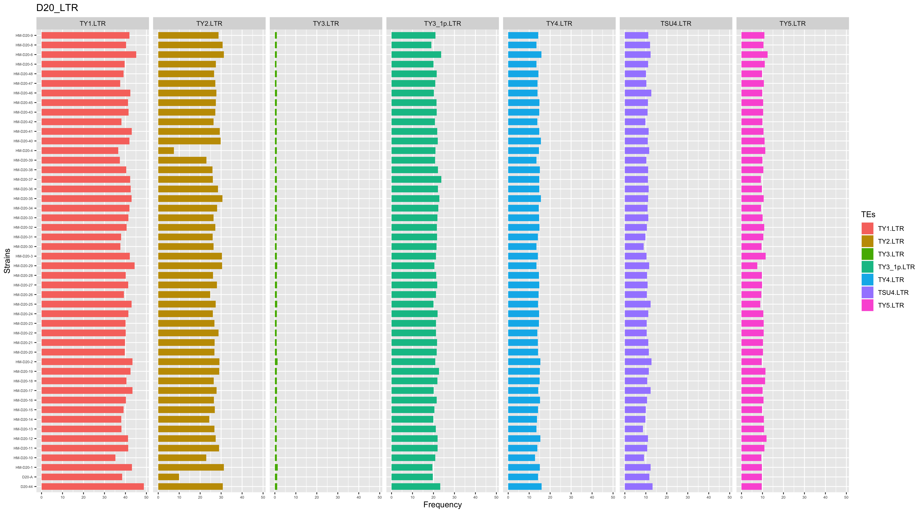

Slide 29
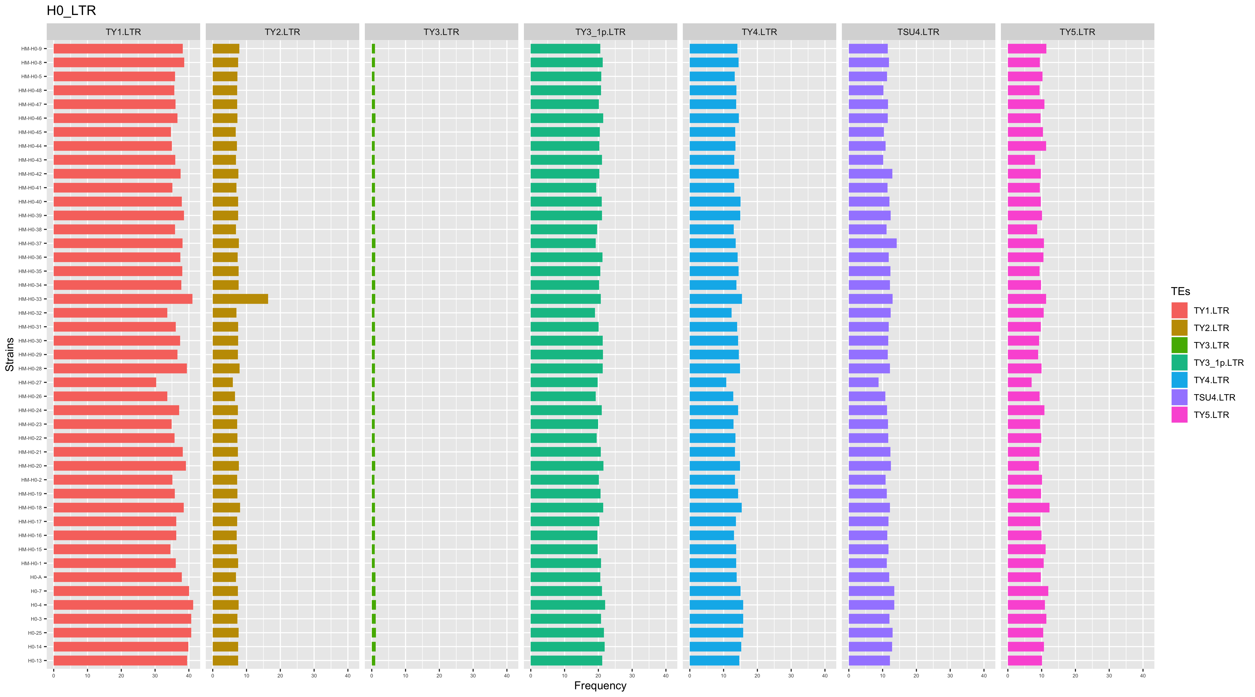

Slide 30
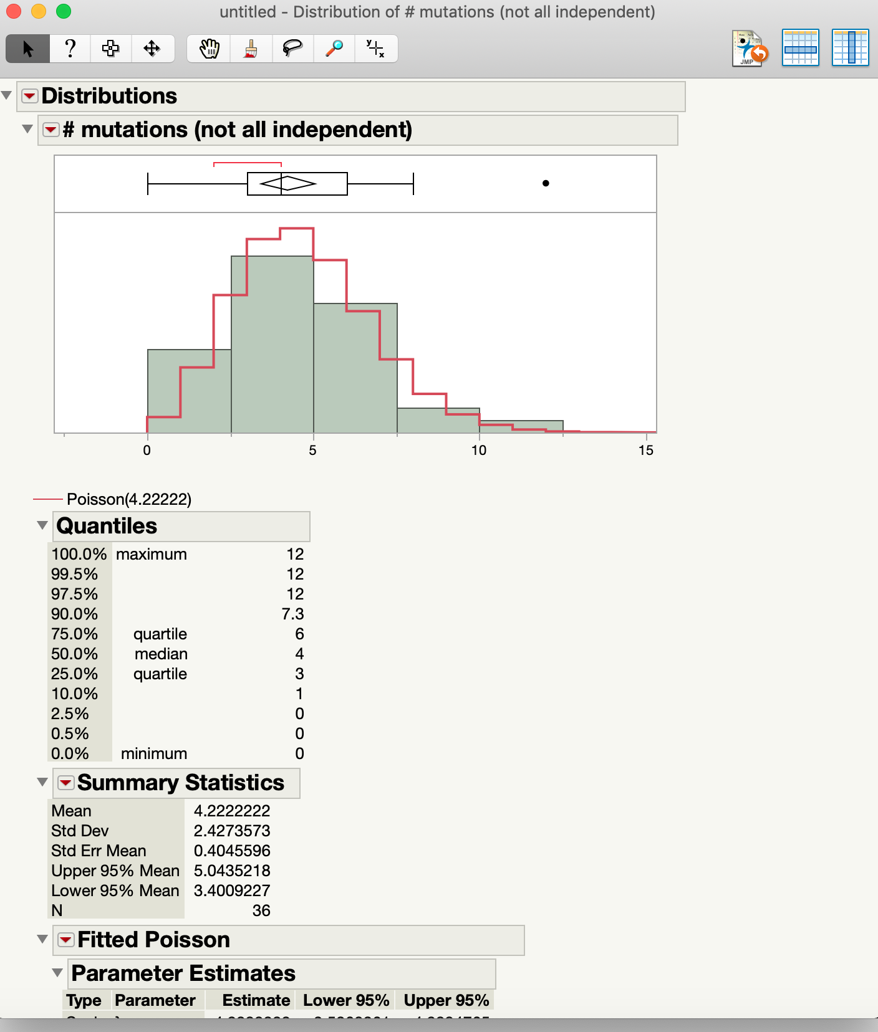
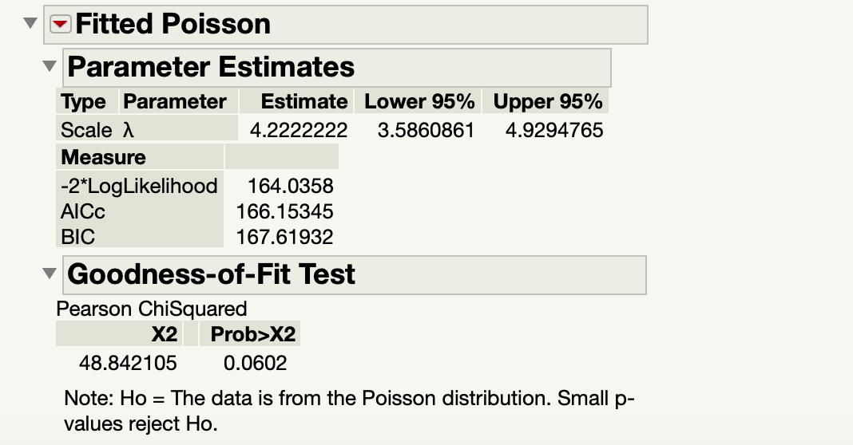
Fit Poisson to number of SNM mutations per line H0

Slide 31
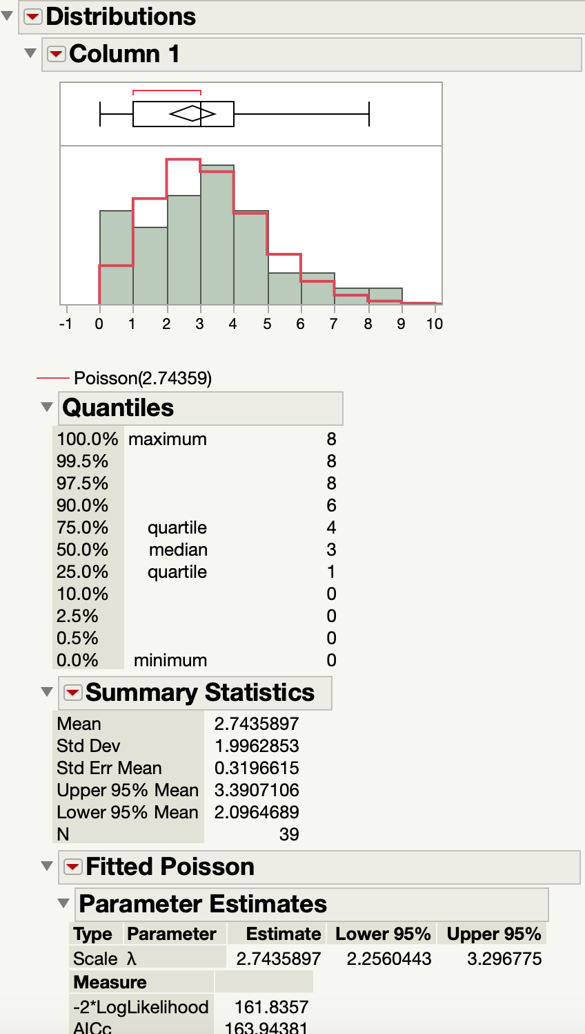
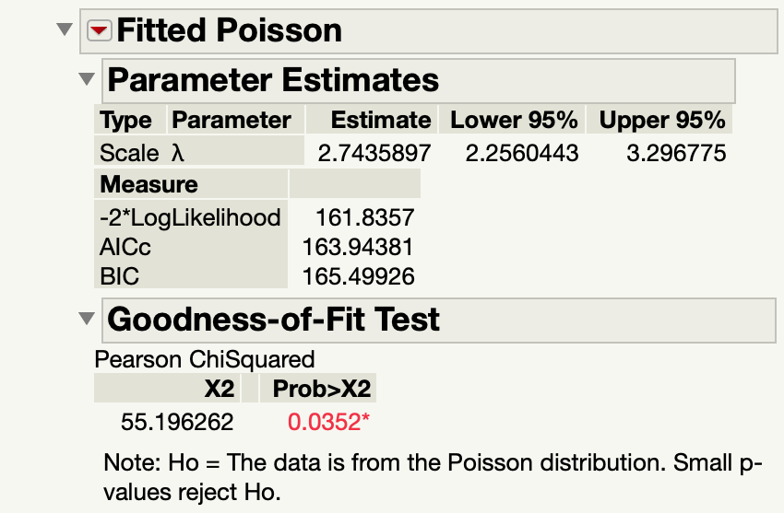
Poisson doesn’t fit D0 mutations per line

Slide 32
Differences between 337 ref genome and ancestors
D1 ancestor variants
Chr Pos GT Type
IV 641630 2/2 ALT – indel (het in D20 & majority of progeny)
VII 61782 1/1 ALT – indel
VII 986079 1/1 ALT – SNP (not in D20)
XV 299062 1/1 ALT – SNP (not in D20)
XVI 186933 2/2 ALT – SNP

Slide 33
Differences between 337 ref genome and ancestors
D0 ancestor variants
Chr Pos GT Type
IV 641630 2/2 ALT – indel
VII 61782 1/1 ALT – indel
XIII 111478 ½ ALT – indel
XV 314234 ½ ALT – indel

Slide 34
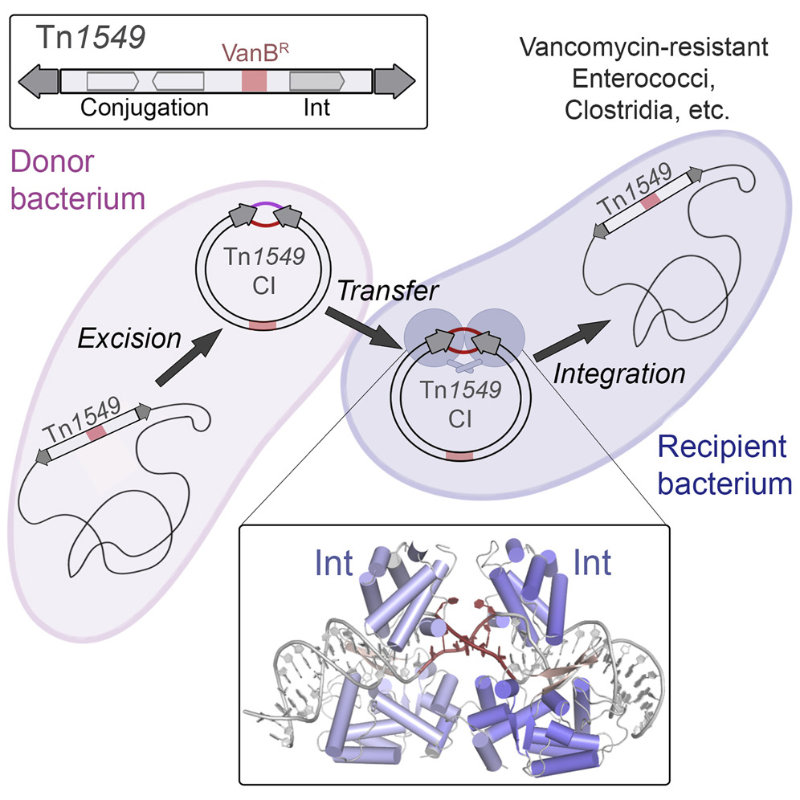
Transposons mediate antibiotic resistance
Modified from Rubio-Cosials et al 2018
https://doi.org/10.1016/j.cell.2018.02.032
Notes:
Horizontal gene transfer via plasmid intermediate

Slide 35
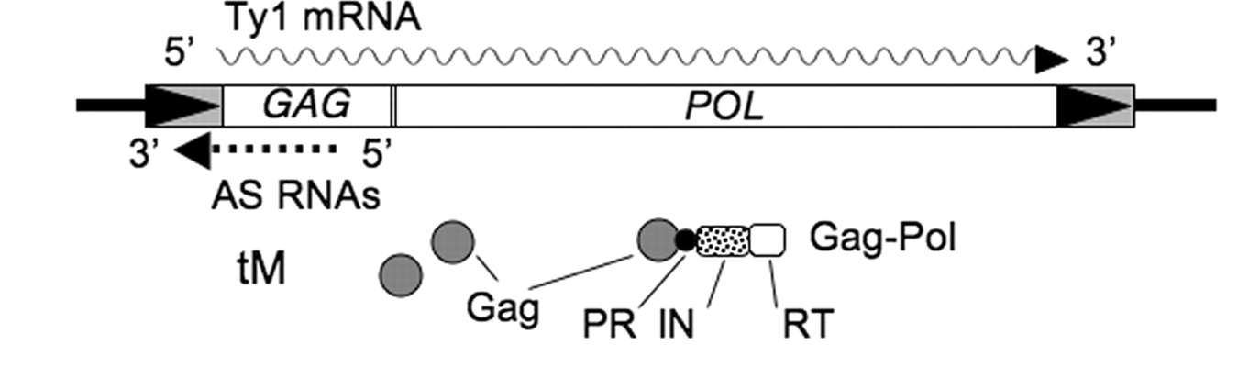
Copy Number Control (CNC)
Negative feedback: more Ty1s = less Ty1 transcription
p22: truncated Gag protein that inhibits virus-like particle formation
Antisense RNAs:
Inhibit Pol processing
Destabilize RT and IN
Inhibit Met tRNA annealing
Notes:
Add animations
Model for Ty1 CNC.
Gag and Gag-Pol precursor proteins, Ty1AS RNA, Ty1 mRNA, and tRNA-Meti (tM) are shown during VLP assembly and protein maturation.
In CNC- VLPs lacking Ty1AS RNAs, efficient VLP assembly, protein processing, and reverse transcription occurs.
Ty1 mRNA/AS RNA base paring may be required for copackaging into CNC VLPs.
Ty1AS RNAs may inhibit several steps in the process of retrotransposition such as blocking the cleavage of the Pol precursor protein by PR, destabilizing IN and RT, or preventing tRNA-Meti annealing with the mRNA.

Slide 36
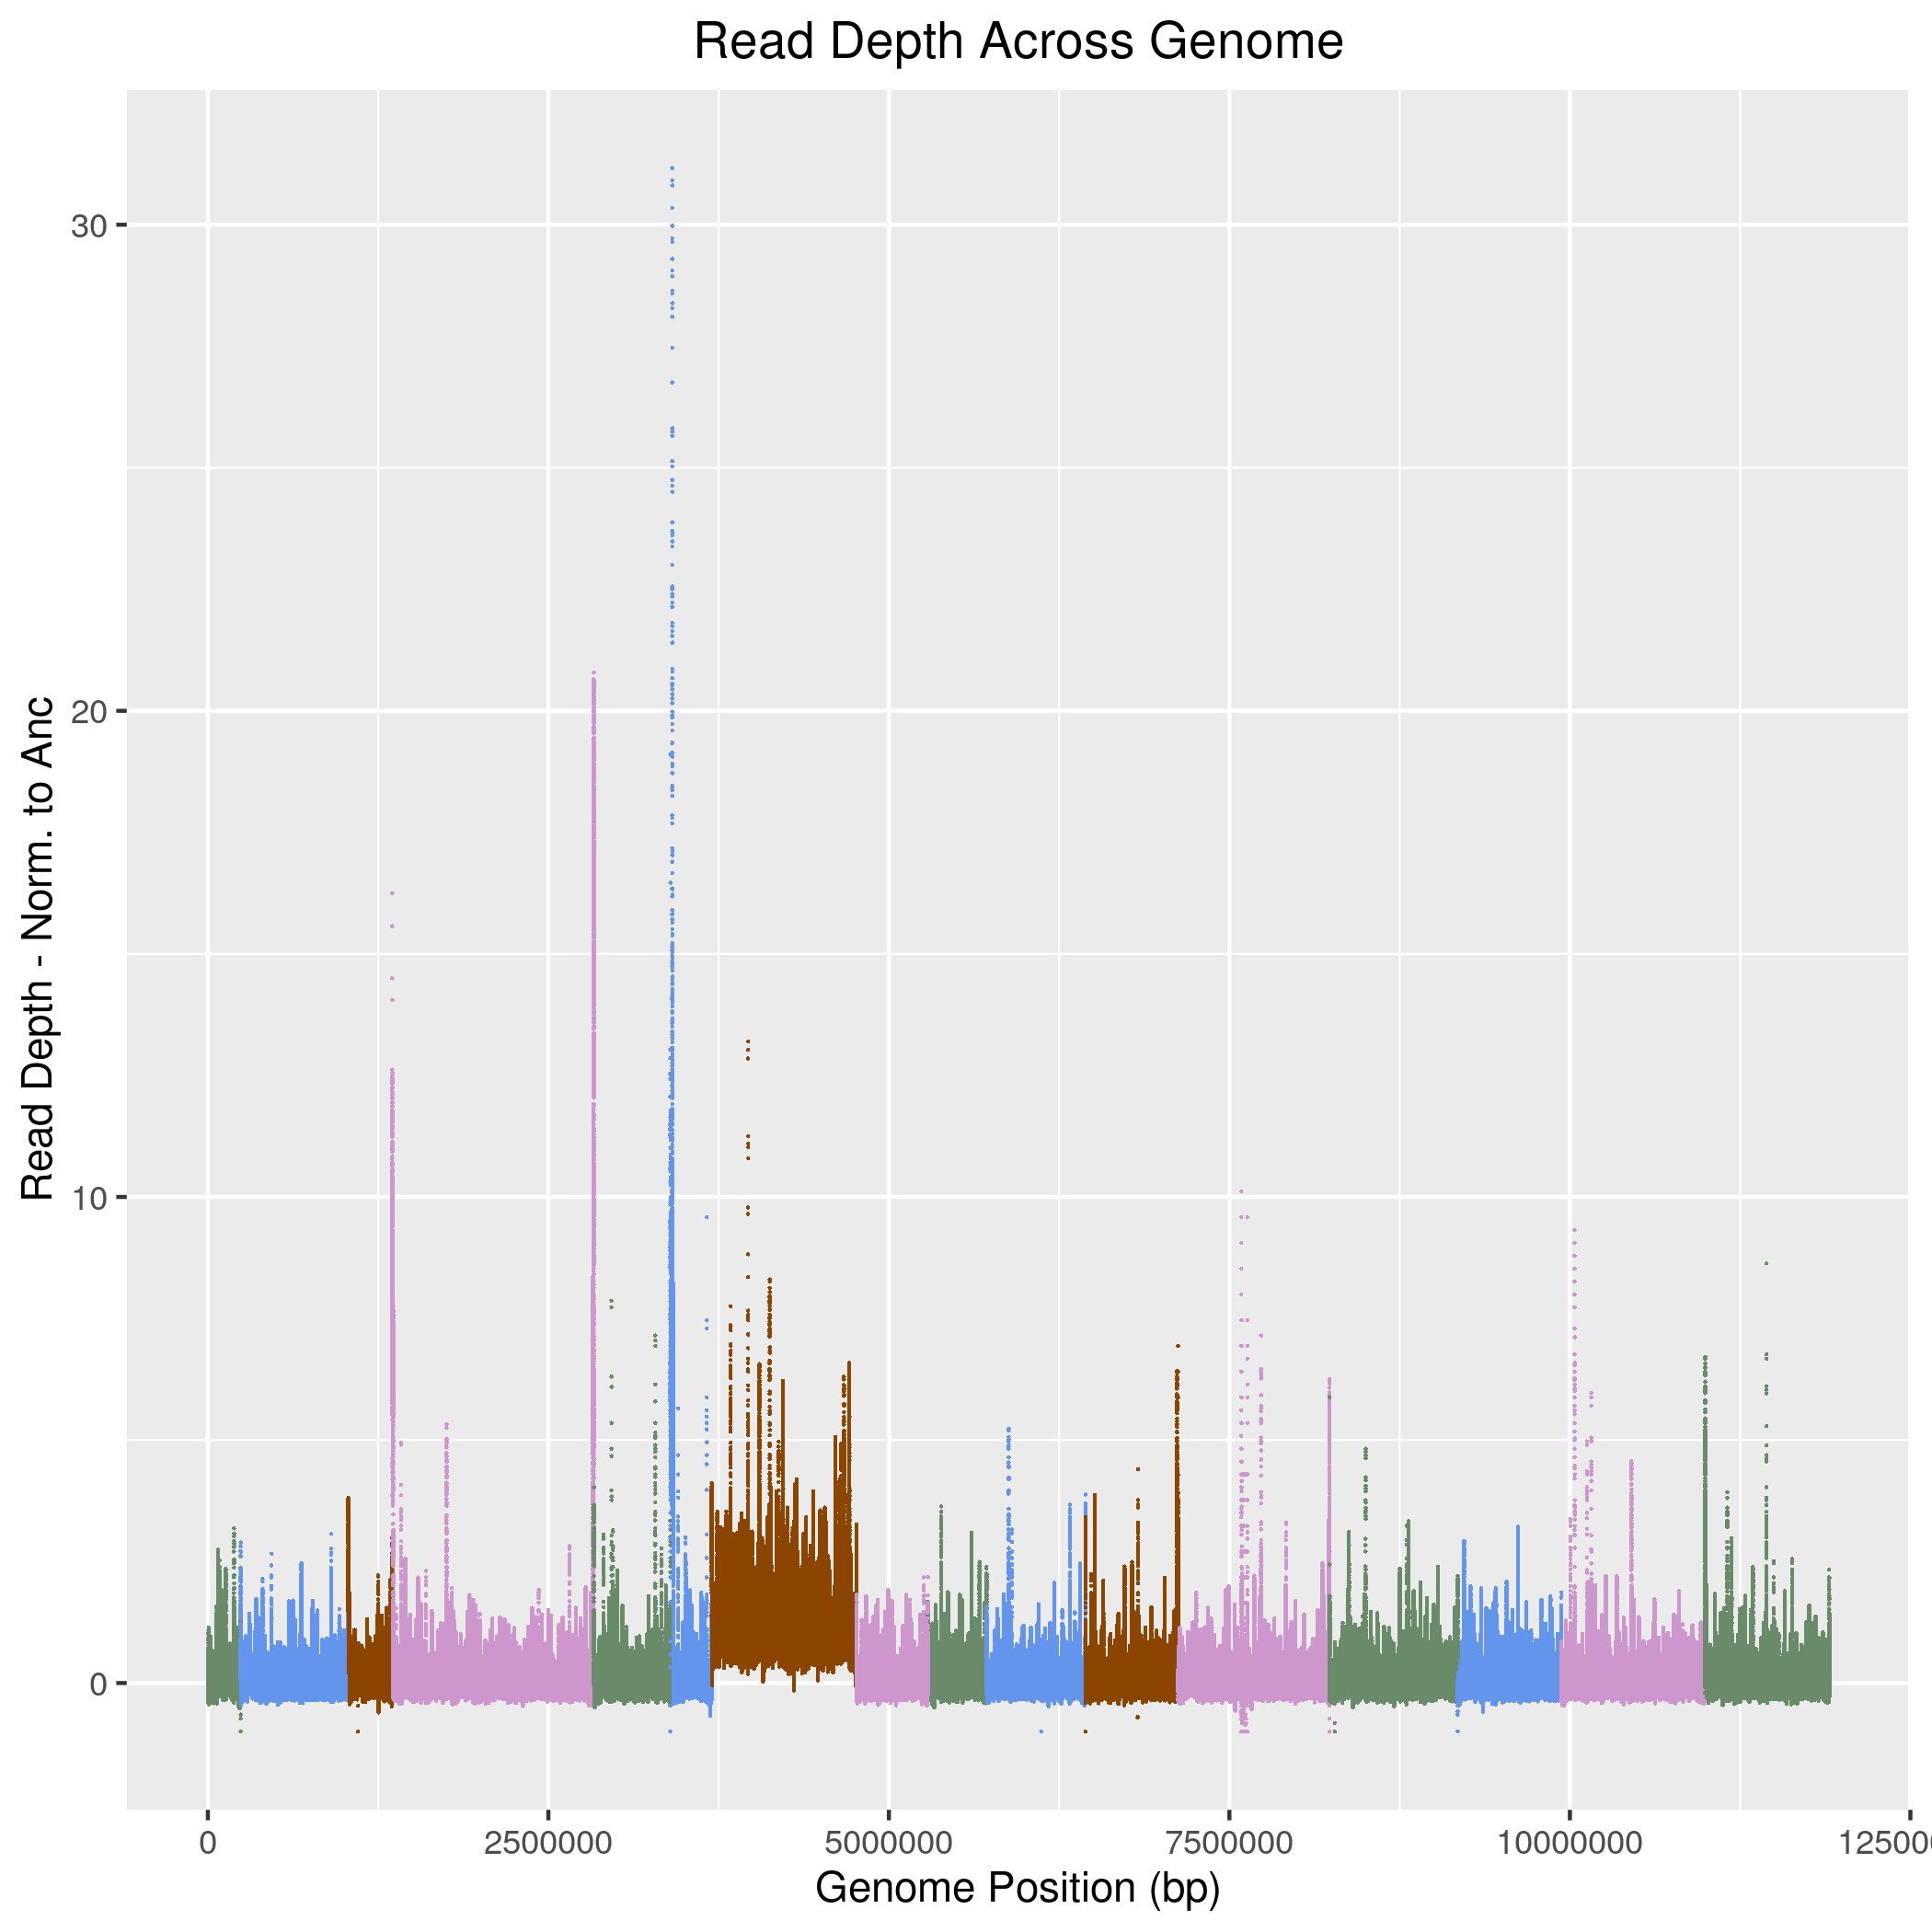
9.23 x 10⁻⁷ events/generation/chromosome
Notes:
One whole-chromosome disomy event of chromosome VII was found in Line 43 of the H0 strain.
No ty1 strain had disomy
Ty1 strain didn’t

Slide 37
Mutation consequences of indels and SNMs in each strain
Notes:
Check these numbers!!

